Slide 1
Resurrection Endowment Fund 2025
From the Endowment Fund Charter/Bylaws:
“The purpose of the Lutheran Church of the Resurrection Endowment Fund is to enhance the work of the church by establishing new ministries and stewardship opportunities in addition to and apart from the general operation of the church and outside of the church budget.”
Current Members:
Nikki D’Amour Mary Hauch
Steve Jacobson Gayle Wint

Slide 2
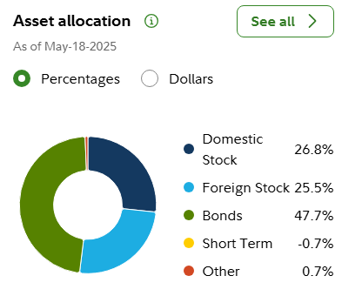
Lutheran Church of the Resurrection
Endowment Fund
1st Quarter, 2025
 | Assets: |  |  | Beginning Quarter Balance |  | January |  | February |  | March
 | ### | Fidelity Investments |  | $ 205,193.66 |  | $ 209,858.34 |  | $ 211,765.41 |  | $ 208,339.27
 | ### | Racine Community Foundation* |  | $ 28,937.54 |  | $ 28,937.54 |  | $ 28,937.54 |  | $ 28,937.54
 | Total Assets |  |  | $ 234,131.20 |  | $ 238,795.88 |  | $ 240,702.95 |  | $ 237,276.81
 |  | Month Return |  |  |  | 2.0% |  | 0.8% |  | -1.5%
 | Principal Accounting:
 |  | Principal (Corpus) |  | $ 135,277.65 |  | $ 135,277.65 |  | $ 135,277.65 |  | $ 135,452.65
 |  | Available Funds (Ttl Assets less Principal) |  | $ 98,853.55 |  | $ 103,518.23 |  | $ 105,425.30 |  | $ 101,824.16
 |  | 15% Reserve (of available funds) |  | $ 14,828.03 |  | $ 15,527.73 |  | $ 15,813.80 |  | $ 15,273.62
 | FUNDS AVAILABLE TO SPEND |  |  | $ 84,025.52 |  | $ 87,990.50 |  | $ 89,611.51 |  | $ 86,550.54
 |  | (Available Funds less Reserve)
 | Reasonable & Prudent Annual Spendable (4.0% of Rolling 20 qtrs Avg Total Assets) |  |  |  |  |  |  |  |  | $ 8,017.14
 | QTD Total Return: 1.3%
* May 18, 2025 Fidelity balance is $214,965.78

Slide 3
Resurrection Endowment Fund
Historical Grants (Money Disbursed):
2,000.00 Hospitality Center (2019)
1,000.00 Cops & Kids Reading
2,000.00 Bethany House of Caring
3,000.00 Tiny Homes-Milwaukee
1,000.00 Hopes Center of Racine
3,200.00 Tiny Home (Sunday School Matching)
1,750.00 LCR Video Equipment (2020)
2,000.00 Hospitality Center of Racine
1,000.00 Racine County Food Bank
1,000.00 Faithworks Food Pantry
1,000.00 Holy Communion Food Pantry

